Slide 1

Delay
By
Dr.Rohit Lorenzo
Assistant Professor Sr. Grade -1
School of Electronics Engineering (SENSE)

Slide 2
Talk Outline
Delay Definitions
Timing Optimization
RC Delay
Problems
Logical Effort

Slide 3
Delay Definitions
Propagation delay time, tpd = maximum time from the input crossing 50% to the output crossing 50% .
Contamination delay time, tcd = minimum time from the
input crossing 50% to the output crossing 50%.
Rise time, t_{r} = time for a waveform to rise from 20% to
80% of its steady-state value.
Fall time, t_{f} = time for a waveform to fall from 80% to
20% of its steady-state value.
Edge rate, t_{rf} = (t_{r} + t_{f} )/2

Slide 4
Continue….
when an input changes, the output will retain its old value for at least the contamination delay and take
on its new value in at most the propagation delay.
Rise/fall times are also sometimes called slopes or edge rates.
Propagation and contamination delay times are also called max-time and min-time.
The gate that charges or discharges a node is called the driver and the gates and wire being driven are called the load.
Propagation delay is usually the most relevant value of interest, and is often simply called delay.
The nodes are classified as inputs, outputs, and internal nodes. The user must specify the arrival time of inputs and the time data is required at the outputs.
The timing analyzer computes the arrival times at each node and checks that the outputs arrive by their required time.
The slack is the difference between the required and arrival times. Positive slack means that the circuit meets timing. Negative slack means that the circuit is not fast enough.

Slide 5
Continue….
Critical Path - The critical path is the longest path in the circuit.

Slide 6

Continue…..
Setup Time: The amount of time the data at the synchronous input (D) must be stable before the active edge of clock.
Hold Time: The amount of time the data at the synchronous input (D) must be stable after the active edge of clock.

Slide 7
Delay of a single gate
S_{ir} – Input rise & S_{of} – Output Fall

Slide 8
RC Model of a transistor

Slide 9
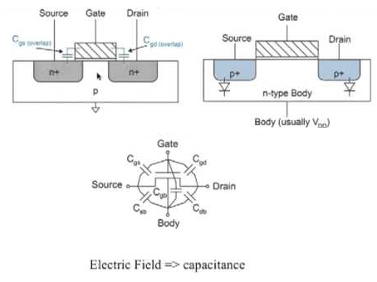
Capacitances
Voltage dependence capacitance
C = dq/dv

Slide 10
Simplified Model
C_{s} = AS× C_{jbs} + PS × C_{jbsw}
AS = Area of Diffusion region = D×W
PS = Perimeter of Diffusion region = 2W+2D
C_{jb}= Unit area capacitance to body
C_{jbsw} =Units of capacitance/length

Slide 11
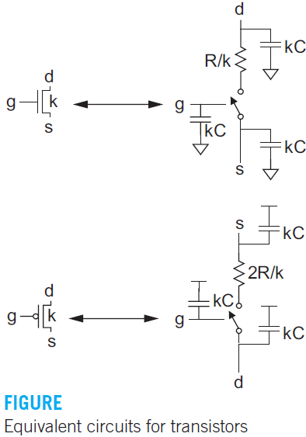
Sizing Impact on R and C
Figure shows equivalent RC circuit models for nMOS and pMOS
transistors of width k with contacted diffusion on both source and drain.
The pMOS transistor has approximately twice the resistance of the
nMOS transistor because holes have lower mobility than electrons.

Slide 12
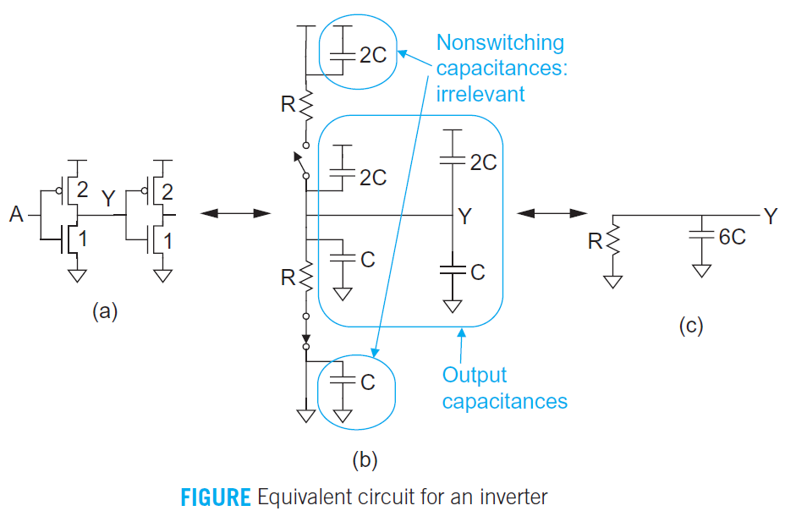
Equivalent Circuit of Inverter
Figure shows the equivalent circuit for a fanout-of-1 inverter with negligible wire capacitance.
The unit inverters of Figure are composed from an nMOS transistor of unit size and a pMOS transistor of twice unit width to achieve equal rise and fall resistance.
If input A rises, the nMOS transistor will be ON and the pMOS OFF.
The capacitors shorted between two constant supplies are also removed because they are not charged or discharged

Slide 13
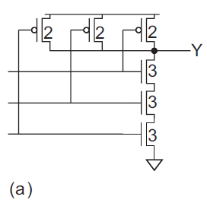
Problem 1
Q) Sketch a 3-input NAND gate with transistor widths chosen to achieve effective rise and fall resistance equal to that of a unit inverter (R). Annotate the gate with its gate and diffusion capacitances. Assume all diffusion nodes are contacted. Then sketch equivalent circuits for the falling output transition and for the worst-case rising output transition ?
Solution :
The three nMOS transistors are in series so the resistance is three times that of a single transistor. Therefore, each must be three times unit width to compensate. In other words, each transistor has resistance R/3 and the series combination has resistance R.The two pMOS transistors are in parallel. In the worst case (with one of the inputs low), only one of the pMOS transistors is ON. Therefore, each must be twice unit width to have resistance R.

Slide 14
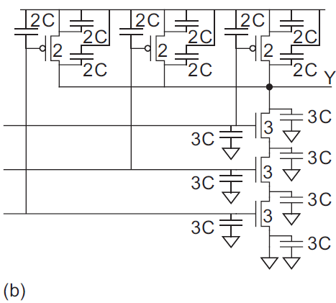
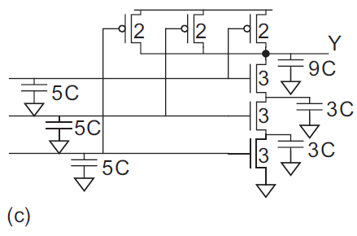
Continue….
Figure (b) shows the capacitances. Each input presents five units of gate capacitance to whatever circuit drives that input. Notice that the capacitors on source diffusions attached to the rails have both terminals shorted together so they are irrelevant to circuit operation. Figure (c) redraws the gate with these capacitances deleted and the remaining capacitances lumped to ground.

Slide 15
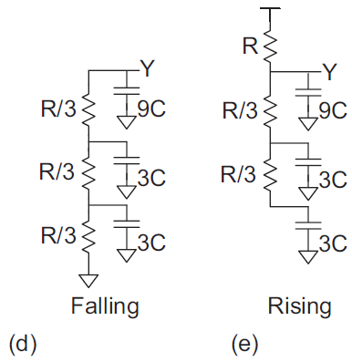
Continue….
Figure (d) shows the equivalent circuit for the falling output transition. The output pulls down through the three series nMOS transistors. Figure 4.7(e) shows the equivalent circuit for the rising output transition. Inthe worst case, the upper two inputs are 1 and the bottom one falls to 0. The output pulls up through a single pMOS transistor. The upper two nMOS transistors are still on, so the diffusion capacitance between theseries nMOS transistors must also be discharged.

Slide 16

Elmore Delay
Most circuits of interest can be represented as an RC tree, i.e., an RC circuit with no loops. The root of the tree is the voltage source and the leaves are the capacitors at the ends of the branches.
The Elmore delay model estimates the delay from a source switching to one of the leaf nodes changing as the sum over each node i of the capacitance C_{i} on the node, multiplied by the effective resistance R_{is} on the shared path from the source to the node and the leaf.

Slide 17
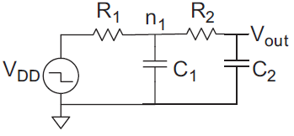
Problem2
Q) Compute the Elmore delay for Vout in the 2nd order RC system from Figure?
Solution
The circuit has a source and two nodes. At node n₁, the capacitance is C₁ and the resistance to the source is R₁. At node V_{out}, the capacitance is C₂ and the resistance to the source is (R₁ + R₂). Hence, the Elmore delay is t_{pd} = R₁C₁ + (R₁ + R₂)C₂

Slide 18
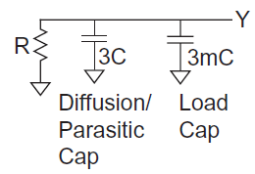
Problem3
Q) Estimate Elmores delay for a unit inverter driving m identical unit inverters.?
Solution
Each load inverter presents 3C units of gate capacitance, for a total of 3mC. The output node also sees a capacitance of 3C from the drain diffusions of the driving inverter. This capacitance is called parasitic because it is an undesired side-effect of the need to make the drain large enough to contact. The parasitic capacitance is independent of the load that the inverter is driving. Hence, the total capacitance is (3 + 3m)C. The resistance is R, so the Elmore delay is tpd = (3 + 3m)RC. The equivalent circuit for the rising transition gives the same results.

Slide 19
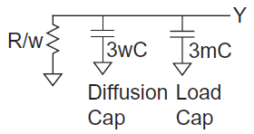
Problem4
Q) Repeat the previous problem if the driver is w times unit size. Calculate the fan-out of a gate?
Solution
The driver transistors are w times as wide, so the effective resistance decreases by a factor of w . The diffusion capacitance increases by a factor of w. The Elmore delay is tpd = ((3w + 3m)C)(R/w) = (3 + 3m/w)RC.
Define the fanout of the gate, h, to be the ratio of the load capacitance to the input capacitance. (Diffusion capacitance is not counted in the fanout.) The load capacitance is 3mC. The input capacitance is 3wC. Thus, the inverter has a fanout of h = m/w and the delay can be written as (3 + 3h)RC

Slide 20
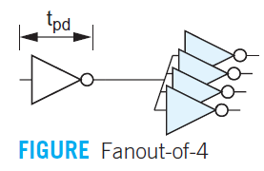
Problem5
Q)If a unit transistor has R = 10 kΩ and C = 0.1 fF in a 65 nm process, compute the delay, in picoseconds, of the inverter in Figure 4.14 with a fanout of h = 4 ?
Solution
The RC product in the 65 nm process is (10 kΩ)(0.1 fF) = 1 ps. For h = 4, the delay is (3 + 3h)(1 ps) = 15 ps. This is called the fanout-of-4 (FO4) inverter delay and is representative of gate delays in a typical circuit.

Slide 21
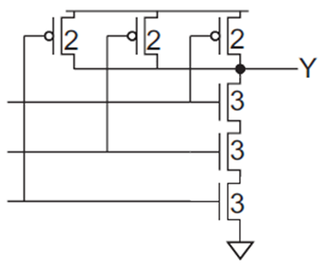
Problem 6
Q) Estimate t_{pdf} and t_{pdr} for the 3-input NAND gate from given figure (Problem1) if the output is loaded with h identical NAND gates?

Slide 22
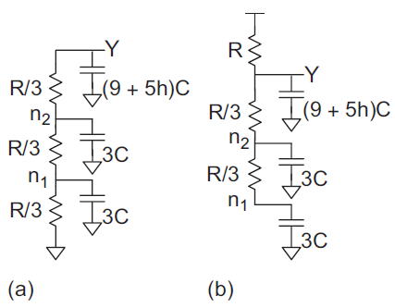
Solution
Each NAND gate load presents 5 units of capacitance on a given input. Figure (a) shows the equivalent circuit including the load for the falling transition. Node n1 has capacitance 3C and resistance of R/3 to ground. Node n2 has capacitance 3C and resistance (R/3 + R/3) to ground. Node Y has capacitance (9 + 5h)C and resistance (R/3 + R/3 +R/3) to ground. The Elmore delay for the falling output is the sum of these RC products, tpdf = (3C)(R/3) + (3C)(R/3 + R/3) + ((9 + 5h)C)(R/3+ R/3 + R/3) = (12 + 5h)RC.
Figure 4.15(b) shows the equivalent circuit for the falling transition. In the worst case, the two inner inputs are 1 and the outer input falls. Y is pulled up to VDD through a single pMOS transistor. Node Y has capacitance (9 + 5h)C and resistance R to the VDD supply. Node n₂ has capacitance 3C
The relevant resistance is only R, not (R + R/3), because the output is being charged only through R. This is what is meantby the resistance on the shared path from the source (VDD) to the node (n2) and the leaf(Y). Similarly, node n1 has capacitance 3C and resistance R. Hence, the Elmore delayfor the rising output is tpdr = (3C)R +(3C)R +(9=5h)R= (15 + 5h)RC.

Slide 23
Thank You

